Slide 1
FPGA + Neuromorphic Lecture 1
Introduction to Biological & Artificial Neurons (Theory)

Slide 2
How the Lectures Will be Structured
30 minutes: mini-lesson
15 minutes: small implementation
15 minutes: questions

Slide 3
Introduction to Biological & Artificial Neurons

Slide 4
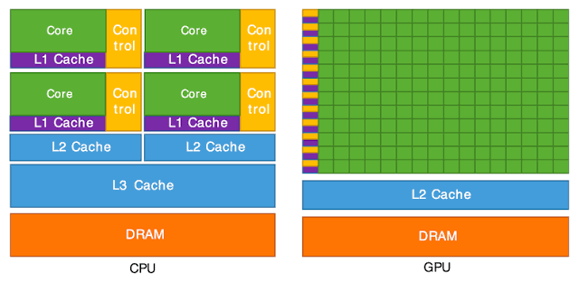
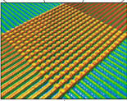
What is Neuromorphic Computing?
The von Neumann Bottleneck vs. Co-located Architecture
Event-Driven (Sparsity) Processing
Notes:
The von Neumann Bottleneck vs. Co-located Architecture
Visual: Side-by-side architecture diagram.
Left: CPU/GPU showing constant energy-expensive data movement between the Memory (DRAM) and Logic/ALU across a bus.
Right: Neuromorphic crossbar array where memory cells (synapses) are the computational units.
Beginner Takeaway: The human brain runs on ~20 Watts (less than a dim lightbulb) to perform complex real-time sensory processing. A modern GPU cluster performing high-level AI tasks consumes tens of thousands of Watts.
Experienced Takeaway: Spatial locality and memory bandwidth limits (Ebus​≫Ecompute​) dictate modern computing efficiency limits. Neuromorphic architectures solve the data-movement problem by computing directly inside memory banks.
Event-Driven (Sparsity) Processing
Concept: Synchronous clocks vs. asynchronous event-driven execution.
Analogy: Traditional computing is like taking a photo every 1 millisecond regardless of whether anything moves. Neuromorphic computing is like a security camera that only turns on individual pixels when light level changes.

Slide 5
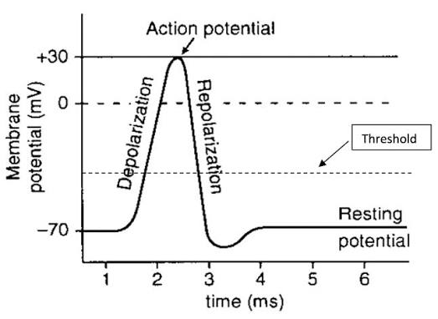
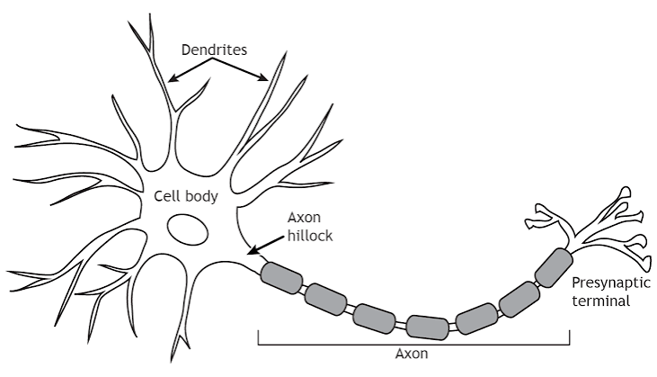
Biological Neurons & Action Potentials
Anatomy of a Neuron
Action Potential
Notes:
Anatomy of the Compute Unit
Visual: Diagram of a biological neuron labeled with both biological terms and engineering equivalents:
Dendrites → Input channels / Buses.
Soma (Cell Body) → Integrator / Comparator / Accumulator register.
Axon → Output line / Transmission wire.
Synapse → Programmable variable weight / Attenuator.
The Action Potential (The "Spike")
Visual: Plot of membrane potential over time (Vm​ vs. t). Annotate the stages: Resting Potential (−70 mV), Depolarization, Spike Peak (+30 mV), Repolarization, and Refractory Period.
Beginner Takeaway: The neuron collects small electrical pulses from its inputs. When the internal voltage crosses a specific threshold line, it fires a standard pulse onward and resets itself to zero.
Experienced Takeaway: Information is encoded in time and frequency (point processes in stochastic time domain), not in static voltage levels. The refractory period imposes a hard physical maximum on firing frequency, preventing signal instability in the network.

Slide 6

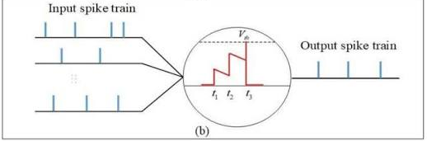
Mathematical Modeling of Neurons
Leaky Integrate Fire Neuron Model
Tao = decay constant
V(t) = Potential
V_rest = resting potential
RI = inputs with synaptic weights
Notes:
The "Leaky Bucket" Intuition
Visual: Diagram of a bucket with a small hole at the bottom.
Inflow: Incoming spike currents filling the bucket.
Water Level: Membrane potential (V(t)).
Hole at the bottom: Natural passive leakage of charge over time.
Float Switch at top: Threshold voltage (Vth​) that triggers a discharge and resets the water level.
The Governing Differential Equation
Equation:
τm​dtdV(t)​=−(V(t)−Vrest​)+Rm​I(t)
Deconstruction for beginners:
V(t): The current voltage level.
τm​: The decay time constant—determines how fast charge leaks away.
Rm​I(t): The incoming electrical current pushed by input synapses.
Reset Condition (Discrete Thresholding):
If V(t)≥Vth​⟹Spike Output=1,V(t)←Vreset​
Experienced Takeaway: This is a first-order linear differential equation with a discontinuous reset boundary condition. In digital logic, this translates cleanly into an accumulator with an arithmetic right-shift (for leakage decay) and a comparator.

Slide 7
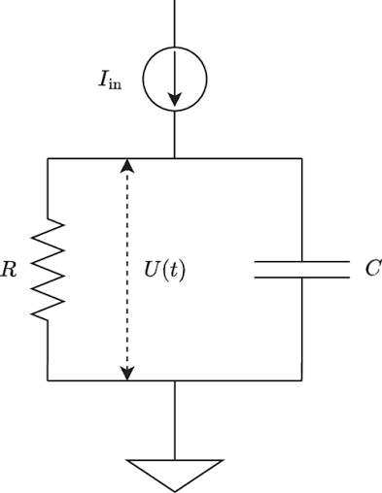
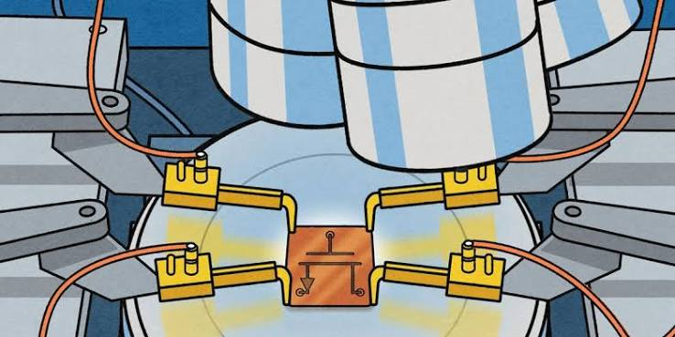
Hardware Perspective
Transistors as switches; emerging memory technologies and Memristors/NSRAM neuron models.
Notes:
Subthreshold Analog CMOS Neurons
Visual: Simple circuit diagram showing a capacitor Cm​ charged by a current source and discharged by a leak transistor.
Concept: If we operate transistors in the subthreshold regime (below their normal ON voltage), the current flowing through them follows an exponential relationship with gate voltage—matching the exponential physics of biological ion channels!
NSRAM & Memristance (The Synapse Problem)
Visual: Crossbar matrix diagram with 2D grid lines (Wordlines & Bitlines) connected at intersections by two-terminal non-volatile memory devices (NSRAM / RRAM / Memristors).
Beginner Takeaway: A normal computer memory cell only remembers 1 or 0. A memristor or NSRAM cell can change its resistance continuously based on how much current has passed through it—it "remembers" its past activity like a biological synapse.
Experienced Takeaway: Ohm's Law (I=G⋅V) performs matrix-vector multiplication in parallel within the analog domain via Kirchhoff's Current Law (∑I=0). This removes the O(N2) memory read cost of deep learning layers down to an O(1) constant-time physical process.

Slide 8
Summary & Roadmap
Concept | Neurobiology | Python Math (Week 2–4) | Hardware / FPGA (Week 5–8)
State Variable | Membrane Potential (Vm​) | Float variable v_mem | Fixed-point Register
Input Signal | Neurotransmitters | Time-series array / list | Digital pulse / Enable flag
Leakage Dynamics | Passive Ion Channels | Multiply by decay factor (e−Δt/τ) | Arithmetic Bit-Shift (>>>)
Synaptic Weight | Receptor density | Scalar floating point weight | Block RAM / Fixed-Point Value
Event Output | Action Potential | Boolean flag / Spike array | Single-bit wire high (1'b1)
Notes:
Preparation for Week 2 Lab
Assignment/Mental Exercise: How do you turn a continuous derivative dtdV​ into a discrete update rule v[t] = v[t-1] + ... that a standard Python for loop can execute without using numpy or torch?

